Slide 1
Explainable ML: Application of different approaches
Violeta Misheva
Data scientist
ABN Amro bank

Slide 2
Agenda
What is explainability?
Why explainability? Why not?
Types of explanations
XAI in the MLOps
Brief technical walkthrough of methods
Coding examples of methods for explainability

Slide 3
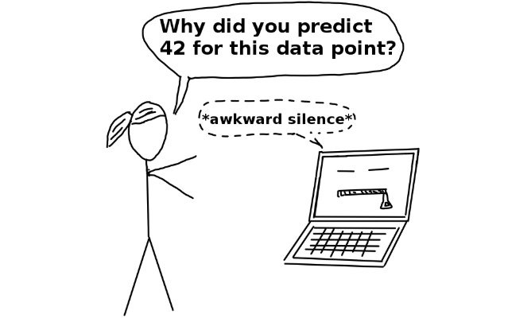
(ONE) Explainability definition
“Methods and models that make the behaviour and predictions of a machine learning model understandable to humans.”

Slide 4

Why explainable AI?
As ‘challengers’ for strictly regulated models
‘Why was I rejected for a loan?’
To increase trust, social acceptance and confidence of business stakeholders
To increase transparency and detection of bias

Slide 5
Why explainable AI?
To increase robustness and reliability of the model
Helps data scientists understand their work better (better grasp of the domain, the interaction of the features and the decision-making process of the model)

Slide 6

Why NOT explainable AI?
Paradoxically: distrust (if uncovering complex, opaque processes and algorithms)

Slide 7

Why NOT explainable AI?
Commercial sensitivity and ‘gaming the system’
‘If I was rejected for a loan because I have too many credit cards, I can just get rid of some of them and then I will be approved, right?’
Notes:
Secondly, we need to be careful not to reveal too much commercially sensitive information when we provide an explanation to a client.

Slide 8

Why NOT explainable AI?
Commercial sensitivity and ‘gaming the system’
‘If my transaction behaviour is flagged as suspicious because I sent many small amounts to specific accounts, if I do it more subtly, then I will be fine.’

Slide 9
What is a good explanation (for humans)?
Contrastive : why a prediction was made instead of another prediction
Why was my loan application rejected, i.e. what factors should I change to make it successful?
Selective: a list of important drivers that explain an outcome
Consistent with prior beliefs: in accordance with intuition

Slide 10
Types of explanations
Intrinsic methods (restricting the complexity of the model) and post-hoc (after the model training)
Model-specific (limited to specific classes of models) and model-agnostic(can be used on any model)
Local (explain an individual prediction) or global(explain the whole model behavior)

Slide 11
Types of explanations
Explaining the data (visual and less visual methods)
Explaining the overall (global) behavior of the model (ex: ‘This algorithm works like this and minimizes that loss function and we know these features matter overall’)
Explaining the decision of the model for each row in the data set (local explanation) (ex: The model has predicted we should not grant this client a mortgage because their income decreases their likelihood to pay it with this much)

Slide 12
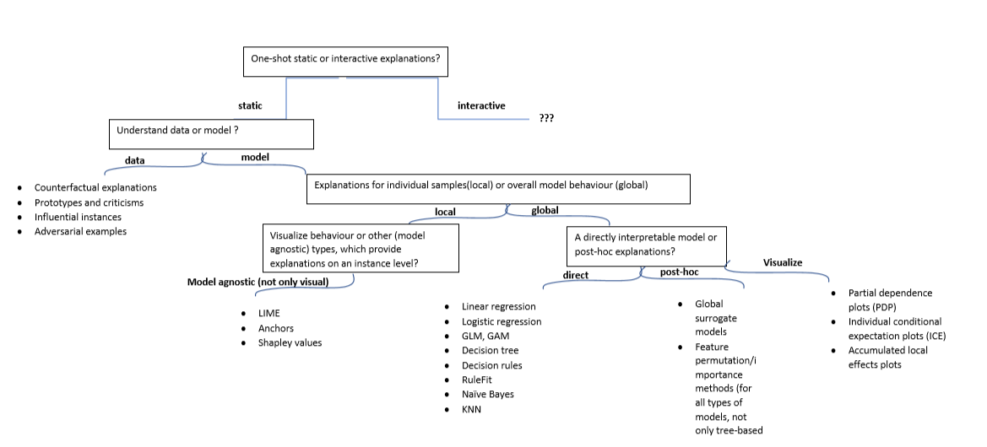
XAI taxonomy

Slide 13
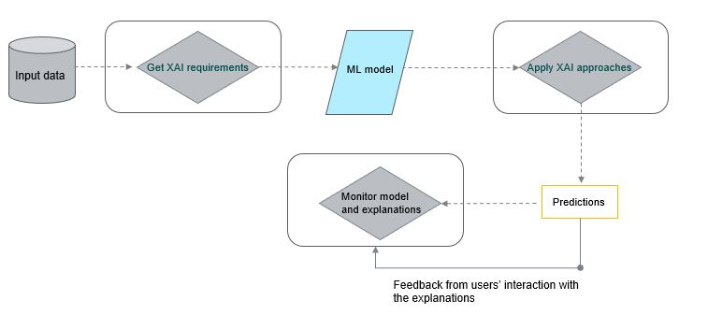
XAI in the development process

Slide 14
What does it mean to ‘explain’ a model?
First important requisite task is to define the explainability needs and requirements of different stakeholders (if there are any, transparency not applicable in all scenarios)
Integrate it as early as possible in the development process (should not be an ‘afterthought’)
One can provide different levels of explanation depending on the context, needs and end-user (one explanation for credit risk manager, a different one for a client, a third for a technical team)
A combination of methods could be provided, it’s not either/or

Slide 15

No one-size-fits-all approach, it’s a process rather than single product

Slide 16
Brief theoretical introduction

Slide 17
RuleFit
Creates new features (in the form of decision rules) and builds a transparent model using these features
Example in the paper (Boston median house prediction):
IF number of rooms > 6.64 AND concentration of nitric oxide <0.67 THEN 1 ELSE 0
In the first step, the algorithm trains a tree-based model predicting the target and uses it to create these decision rules (Result: many rules, not all informative)
Second step: train a sparse linear model, such as a LASSO to select among the original and newly created features.

Slide 18
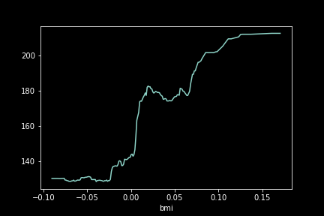
Partial dependency plots (PDP)
The average marginal effect of a feature on the target
It shows whether the relationship between the feature and the target is linear, monotonous or more complex
A main assumption is that the features not included in the PDP are NOT correlated with the one included

Slide 19
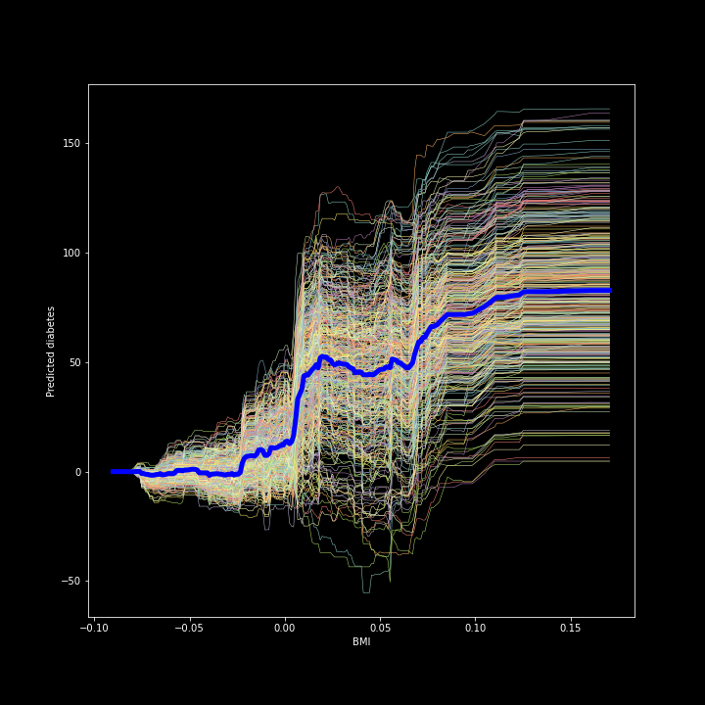
Individual conditional independence (ICE) plots
It shows a line per instance, instead of the average
Can uncover heterogenous effects or potential hidden interactions
Again, if a feature is dependent on another feature, some points in the lines might be invalid
Overall quite intuitive and easy to grasp

Slide 20
Global surrogate
An interpretable model trains to explain a ‘black box’ model
Trains an interpretable model on the dataset of choice and the predictions of the black box model
Keeps track of how well the new model replicates the predictions of the black box model
Since we are approximating an uncertain prediction (approximation of the real data generating process), they are inherently imperfect
Not clear how good of an approximation is ‘good enough’

Slide 21
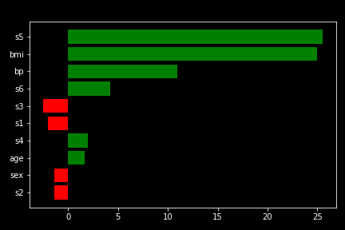
Local interpretable model-agnostic explanations (LIME)
Explains individual predictions
LIME: 1 ) generates a new dataset of permuted samples and corresponding predictions of the black box model; 2) trains an interpretable model on the new dataset, weighted by the proximity of the sampled instances to the instance of interest

Slide 22
Local interpretable model-agnostic explanations (LIME)
The interpretable model should be a good LOCAL approximation but not a global one
In most implementations, need to select number of features in the surrogate model; Most packages use exponential smoothing kernel to define neighbourhood around a point

Slide 23
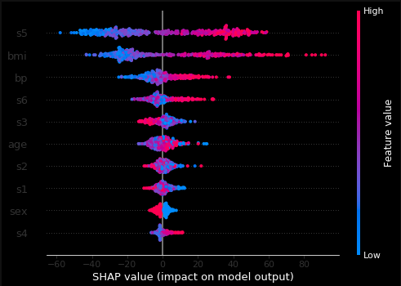
Shapley values
Calculates the marginal contribution of each feature on an instance level compared to the average prediction for the data set
It works for both classification and regression tasks
Computation increases exponentially with number of features

Slide 24
Shapley values
Strong theoretical foundations and ensures the that the difference between the prediction and the average prediction is fairly distributed among the feature values
One of the few methods providing this level of explanation
Considers all features for each instance (important in compliance scenarios)
Higher computational costs, especially if we have many features

Slide 25
CODING WALKTHROUGH
Github link:
https://github.com/VioletaMisheva/XAI_workshop_ODSC2020

Slide 26
Thank you for your attention. Questions?
Connect with me:
LinkedIn: Violeta Misheva
GitHub: https://github.com/VioletaMisheva

